Slide 1
Notes/ Questions
Profitable investment definition?
Austin price per square foot
Do we need to define profitable? – What supports our determination?
Do we need a winner Slide?

Slide 2

Welcome to Austin 78702 or 78745
Austin Schein, Matthew Duncan,
Steven Holloway, Theresa Carrino

Slide 3
Motivation & Summary Slide
Our project will determine whether a home purchase within two Austin area codes would be a more profitable investment with estimated growth by the year 2024. We will use the two zip codes of 78702 and 78745 to evaluate the data for east and south Austin, respectively. Concurrently, we will also examine several factors which can influence a home’s value, such as; the crime rate in the area over a given year, the yearly rating of schools in the zip code, and other related factors, as the data permits. We predict that homes in the 78745 zip code (Southern Austin) area will be more profitable by 2024 than homes in the 78702 zip code (Eastern Austin) area.

Slide 4


Questions & Data
How did schools and crime impact house pricing?
What is the local interest/ new construction in area?
How affordable are the single family houses in the area for the average Austin household?
Did Mortgage rates impact home price?
What is the historical trending for each zip code?

Slide 5

Data Cleanup and Exploration

Slide 6
Data Sources
Zillow API
School Digger API
Data World population CSV
City of Austin CSV
Freddie Mac Mortgage rates CSV and Excel Files
Travis County Appraisal District Office CSV

Slide 7
Process used to get data
Obtain valid street address from Travis County Appraisal District.
Glob the export records.
Remove unwanted zip codes and create a random list for sampling.
Random sample list utilized for Zillow API to retrieve additional details of home data.
(Zillow did not have 1000 calls per day as we understood initially).
Tap other data sources and remove unwanted records and outliers.

Slide 8
Verify Data
School data
Minimal change in school ranking year to year
Crime Data
No significant change
Data world population 2012-2017
Organized
Large file
Zillow sample data
Current data
Constraints- Missing information and inconsistent

Slide 9
Data Analysis

Slide 10
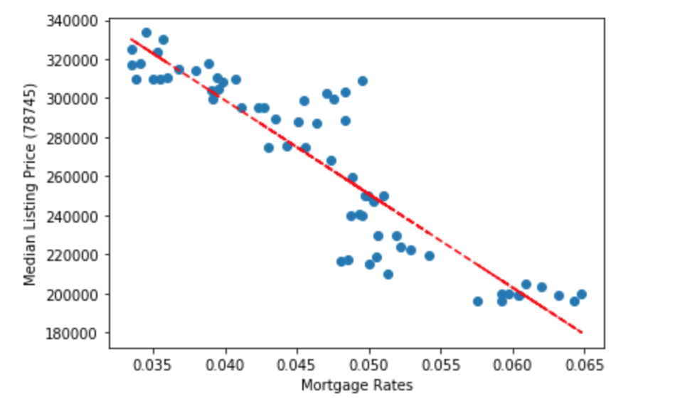
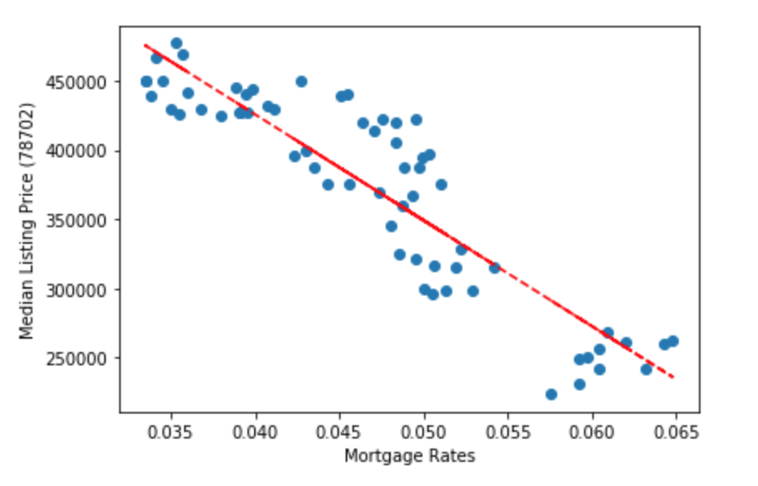
Median Listing and Mortgage Rates
Correlation between Mortgage Rates and
Median Listing Price
78745
78702
Did mortgage rates impact home price?

Slide 11
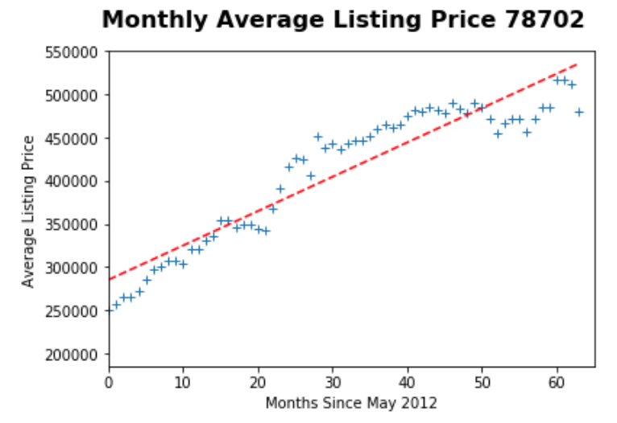
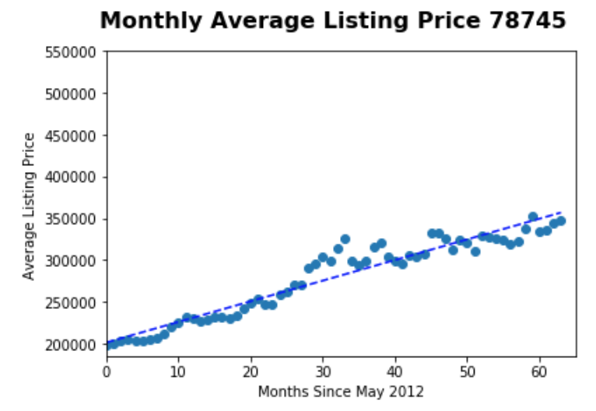
Average Price per month
What is the historical trending for each zip code?

Slide 12
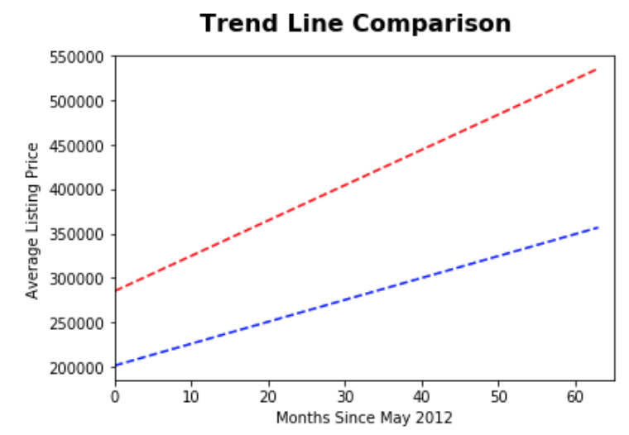
Trend Line
RED- 78702
Slope of line $3,980
BLUE-78745
Slope of lines $2,470

Slide 13
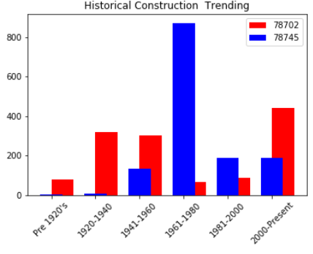
Historical Construction Data
What is the local interest/ new construction in area?

Slide 14
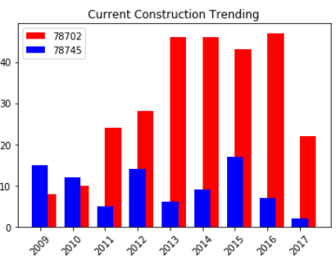
Current Construction Data
What is the local interest/ new construction in area?

Slide 15
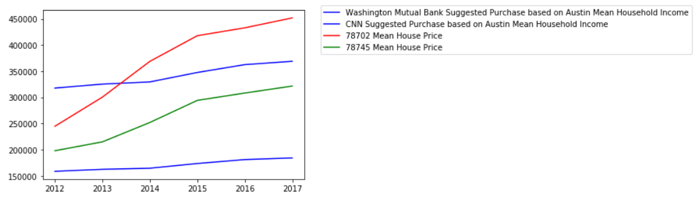
Mean Household Income vs. Sale Price
How affordable are the single-family houses int the area for the average Austin household?

Slide 16



Slide 17
Post Mortem
Population and Demographics of each area would give us better understanding of construction booms we found
Expand zip codes
Evaluate household

Slide 18

Questions

